Slide 1

Build Configure, Price, Quote (CPQ)
Raja Vellayan

Slide 2

Agenda
Industries CPQ Overview
Lead-to-Cash
Order Capture and the Cart
Pricing, Promotions, and Rules
Guided Selling
Enterprise Product Catalogue

Slide 3

Industries CPQ Overview
Introducing Industries CPQ
Cloud based quote and order capture system
Built natively and additively on the Salesforce platform
What features does CPQ Provide?
Enables configuration of product offers for the right customer
It gives sales teams advanced order capture and guided selling capabilities using a powerful rules engine built on the Salesforce platform
Design basic and advanced availability, eligibility, compatibility, and pricing rules.
Standardize new product and service introductions.
Ensure accurate capture of new MACD move, add, change and disconnect orders.
Notes:
Industries CPQ
Industries Configure, Price, Quote (CPQ) is a cloud-based, quote-and-order-capture system that is built natively and additively on the Salesforce platform. It enables the configuration of product offers that are just right for the customer. Driven by underlying EPC product-service-resource (PSR) data, Industries CPQ gives sales teams advanced order-capture and guided-selling capabilities so that they can offer best-fit products and services to customers across different channels.
Industries CPQ has a powerful rules engine built on the Salesforce platform that ensures that quotes and orders are valid before submission, minimizing order delays, customer confusion, and customer dissatisfaction. Industries CPQ picks up where CRM ends, providing real-time product, pricing, and business rules based on natural language and declarative administration.
Industries CPQ supports both business-to-business (B2B) and business-to-consumer (B2C) lead-to-cash processes. The open architecture of the platform allows you to use Industries CPQ components, services, and user interface selectively as individual components and to integrate process flows with external systems, all using a unified user interface.

Slide 4
Industries CPQ Overview
Business Challenges of CPQ
Too much time quoting: Sales agents often spend too much time creating quotes instead of submitting orders, with legacy CRM and custom quoting systems slow to generate quotes.
A multitude of product variations: Businesses have thousands, sometimes millions of product SKUs (stock keeping units) due to numerous and complex products, presenting countless complexities for CPQ systems.
Inconsistency across channels: Companies want to sell product offers based on the same product data through different channels, yet struggle to provide consistent and accurate quotes across different channels, resulting in order fallout and lost business.
Demand for personalization: Customers want quotes for best-fit products based on product availability, alongside their personal preferences and eligibility. Making this contextual information available to sales agents has proven challenging for CPQ systems.

Slide 5
Industries CPQ Overview
How Industries CPQ Solves CPQ Challenges
Challenge: Produce accurate quotes
Solution: Ensure availability and serviceability of products in addition to customer eligibility.
Challenge: Accelerate order capture
Solution: Maximize customer orders with guided quote configuration and order capture.
Challenge: Reduce order fallout
Solution: Enforce business rules to validate the configuration specified during order capture, minimizing the possibility of invalid orders.
Challenge: Improve sales processes
Solution: Provide flexible, configurable sales guidance based on your sales and approval processes and industry best practice
Challenge: Expedite time-to-market
Solution: Enable quick update of products and promotions in response to market changes.

Slide 6
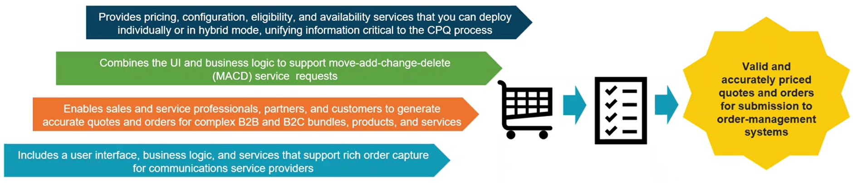
Industries CPQ Overview
Solution Capabilities

Slide 7
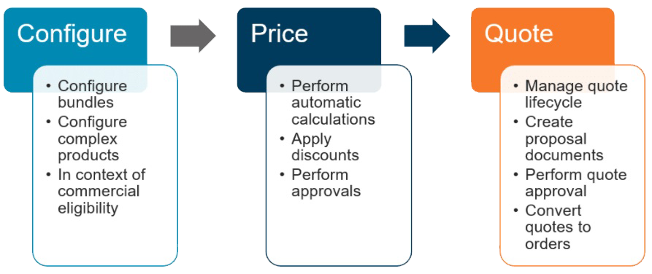
Industries CPQ Overview
Solution Capabilities

Slide 8
Industries CPQ Overview
More About Industries CPQ
Key Features
Improve usability with a consistent UI and seamless functioning across marketing, sales and services.
Better than pre-integrated, due to construction using standard Salesforce objects: Opportunity, Quote, Order, Asset. Syncing of Force.com ISV custom objects is not required.
Build once, deploy everywhere with inherent omnichannel CPQ.
Rich Application Tooling
Improve up-sell and ensure accurate, valid orders with guided selling.
Communications service console, tuned for high-volume, high-complexity CPQ processes, that drives efficiency and reduces operational expenditure.
Click-stream tracking provides insight to selling success and failure.

Slide 9
Industries CPQ Overview
More About Industries CPQ
Openness and Flexibility
Meet the varied and changing needs of service providers operating in a complex application and IT ecosphere.
Work with co-existence-ready, easy-to-integrate external business logic and data.
Accelerate custom needs development with the interface / implementation paradigm.
Context Awareness
Using EPC as the single source of truth for the underlying PSR data, Industries CPQ integrates process flows with external systems and a powerful rules engine to support the order-capture cycle, for example to:
Perform a customer credit check or facility check.
Apply any promotions or discounts for which the customer is eligible.
Run any other applicable rules toward ensuring the perfect order.

Slide 10
Industries CPQ Overview
More About Industries CPQ
Industry-Focused Architecture
Purpose-built for your industry.
Designed with product administrators in mind, with natural language rules, visual administration, and reusable componentized rules definition.
Performance tested at carrier-grade scale.

Slide 11
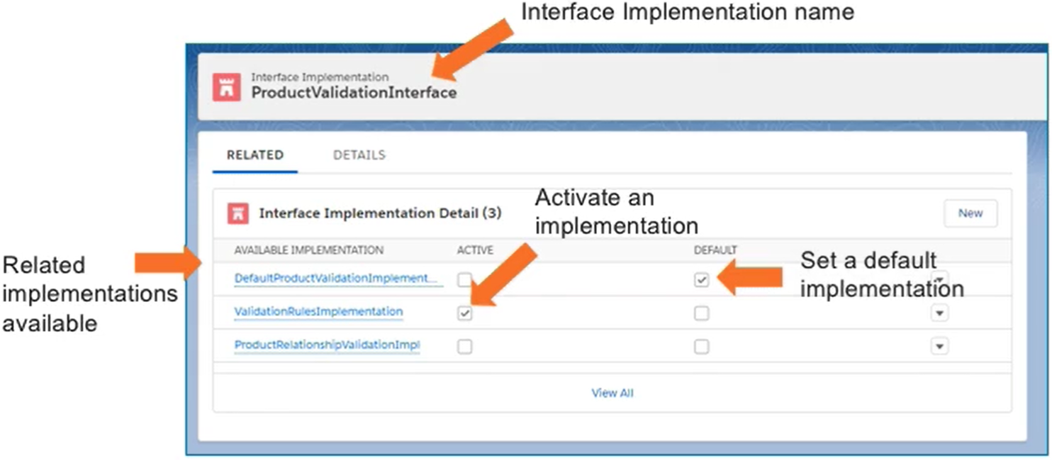
Industries CPQ Overview
Interface Implementations
The core of our open architecture is the interface-and-implementation paradigm.
An interface is a call out to business logic, and an implementation is the business logic itself.
For example, if a pricing interface asks the system, “How much do these items cost?”, the implementation responds with the price of the items.
The Picture shows examples of Industries CPQ interface implementations.
Notes:
Your Industry Cloud provides multiple options for each process and interface, so you can:
Choose an existing implementation that best fits your business needs.
Build your own implementation using Apex.
Develop a hybrid implementation.
Note: For more information on interface implementations, go to Vlocity Success Community. For example, search for "interface implementation".

Slide 12

Industries CPQ Overview
Quiz
1. Industries CPQ supports which of these business activities?
A) The configuration, pricing, and quotation of products.
B) The modelling of cart, pricing, and quotation data structures.
C) The collection, promotion, and quotation of product bundles.
2. Context awareness is an important feature of Industries CPQ.
A) True
B) False
Notes:
Answer:
1 – A
2 – A

Slide 13
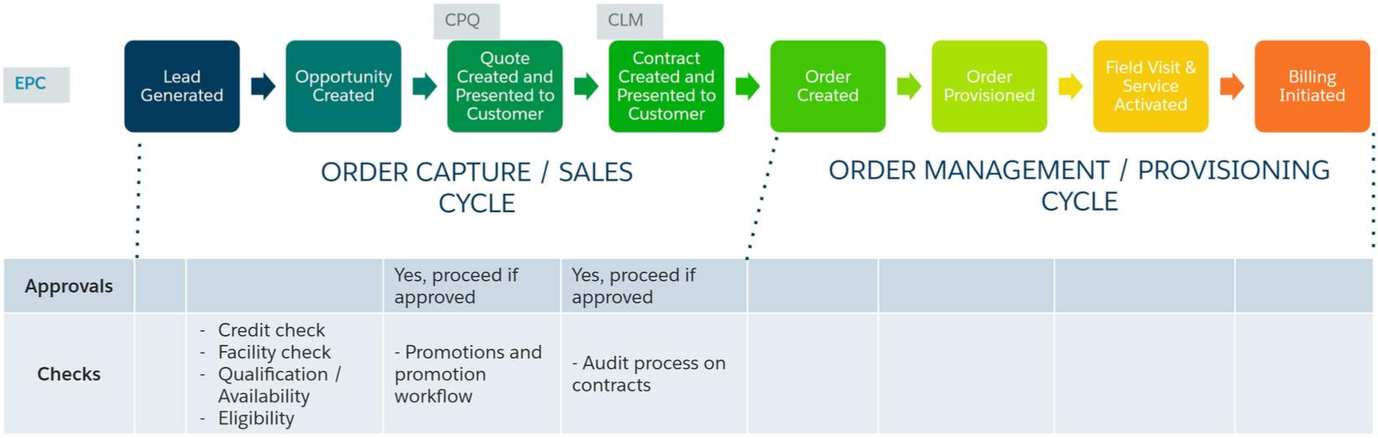
Lead-to-Cash
Lead-to-Cash: Typical Process Flow
The diagram below shows the typical flow of tasks from the generation of a lead to the start of the customer billing cycle and subsequent customer care. Using Industries CPQ, the order-capture process enables the creation of a quote as input to order management systems. A typical lead-to-cash flow involves each of the stages shown below.

Slide 14
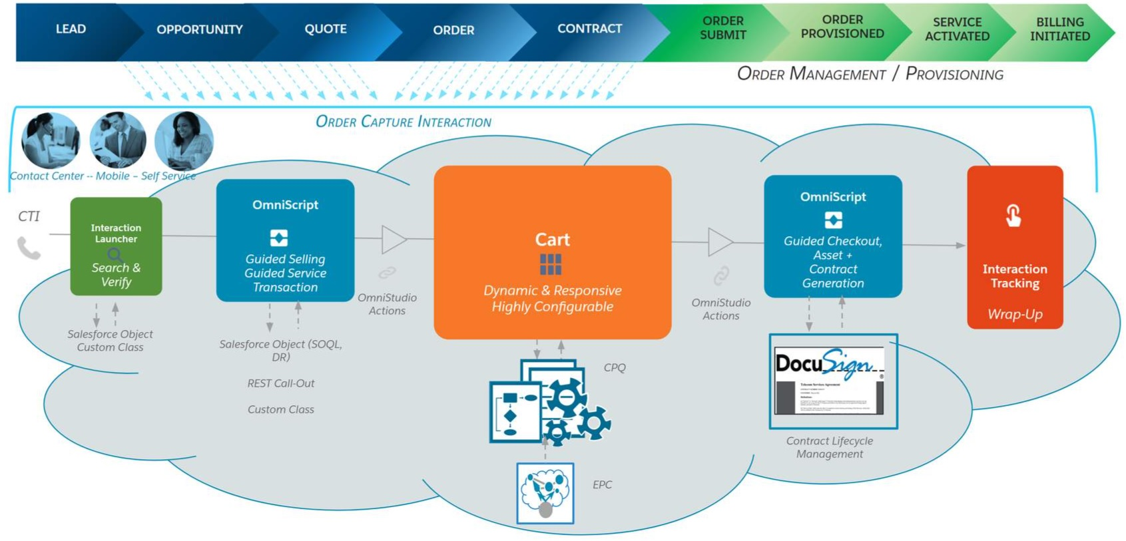
Lead-to-Cash
Enhanced Configure Price Quote
Industries CPQ works in partnership with a number of components in the Digital Interaction Platform to provide enhanced order capture, including EPC and the Cart.
Notes:
OmniScript provides guided selling and guided service transitions as well as guided checkout, asset generation, and contract generation, which you learn about in the Contract Lifecycle Management (CLM) course.

Slide 15
Order Capture and the Cart
Order Capture
With Vlocity CME Order Capture you control the selling process using Vlocity card and an Asset based ordering system. The benefit is users such as the sales teams and Customers Service Representatives (CSR) can do a Varity of business tasks through guided selling to capture accurate orders. Remember that the goal of order capture is to obtain the perfect order because you don't want to lose business through order fallout. In the Order capture process users can select configure and price products and promotions to create quotes that are just right for the customer.
With our order-capture capabilities, you can ensure accurate orders on the way to submitting the perfect order for the customer. Industries CPQ applies business rules to ensure that products and services presented to the customer for purchase are:
Available to the consumer or business account.
Items for which the customer is eligible.
Priced accurately.
Compatible with any existing products and services held by the customer account.

Slide 16

Order Capture and the Cart
The Cart
Vlocity cart is a rich and responsive user interface built on technology to optimize the shopping experience, perfect the purchasing experience and ensure that every order is an accurate order based on CPQ rules. The cart is developed using the Vlocity card framework wherein you can customize Vlocity card by cloning and configuring the cards layouts and templates that are included OOTB with the Vlocity CME manage package. The ability to repurpose existing components dramatically reduces development time and cost compared to building a CPQ application and shopping cart from scratch.
The Cart is the shopping-cart UI provided with Industries CPQ. Developed using the Vlocity Card Framework, you can modify the appearance and behavior of the cart to customize it according to your specific business requirements. The Vlocity Cards framework provides configurable cards, layouts, and templates, which are UI building blocks included out-of-the-box with the Industries CPQ managed package.

Slide 17
Order Capture and the Cart
Quiz
1. The design of the Cart is based on...
A) Layouts, Forms, and Templates
B) Cards, Layouts, and Templates
C) Templates, Diagrams, and Forms
Notes:
Answer:
1 – B

Slide 18
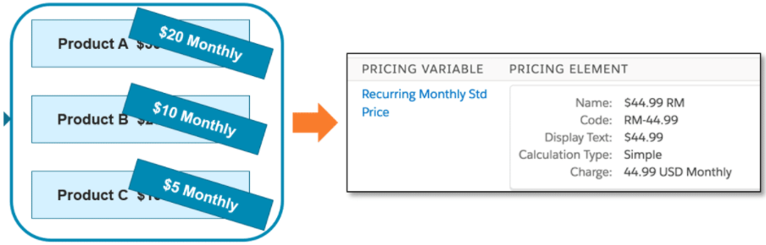
Pricing, Promotions, and Rules
Pricing
Industries CPQ gives you a component-based pricing system with reusable items, such as charges, discounts, adjustments, and penalties. Pricing components are independent of products and allow seamless transitioning to new pricing structures to minimize expense and disruption.
On a daily basis, your company faces many pricing challenges that include:
Grouping products together, yet also keeping them separate.
Discounting individual products in a bundle without changing the base price of individual products when purchased separately.
Limiting product discounts to a specific time frame.
Pricing products differently for different customer groups.
Assigning costs as well as charges to products.
Applying penalties when subscription commitments are broken.
Providing customers with the option of paying for some products with loyalty points.

Slide 19
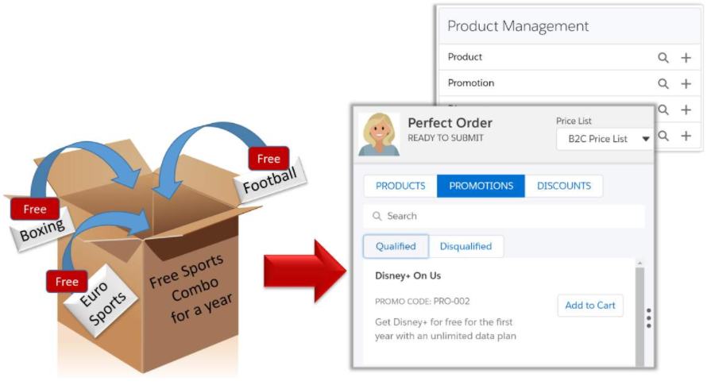
Pricing, Promotions, and Rules
Promotions
You can use the Product Console to create and maintain promotions and discounts. Promotions is a separate module that provides greater flexibility and automated functionality for product promotions and discounts. With Promotions:
Each bundled product you have created can remain intact. Any promotion you create can apply to the product without altering it.
You can apply multiple promotions to one bundle.
You can apply discounted prices in a promotion to existing assets.
You can create contractual and transactional discounts.
Any cardinality changes made to child products within a promotion do not require a refresh of the product hierarchy.

Slide 20
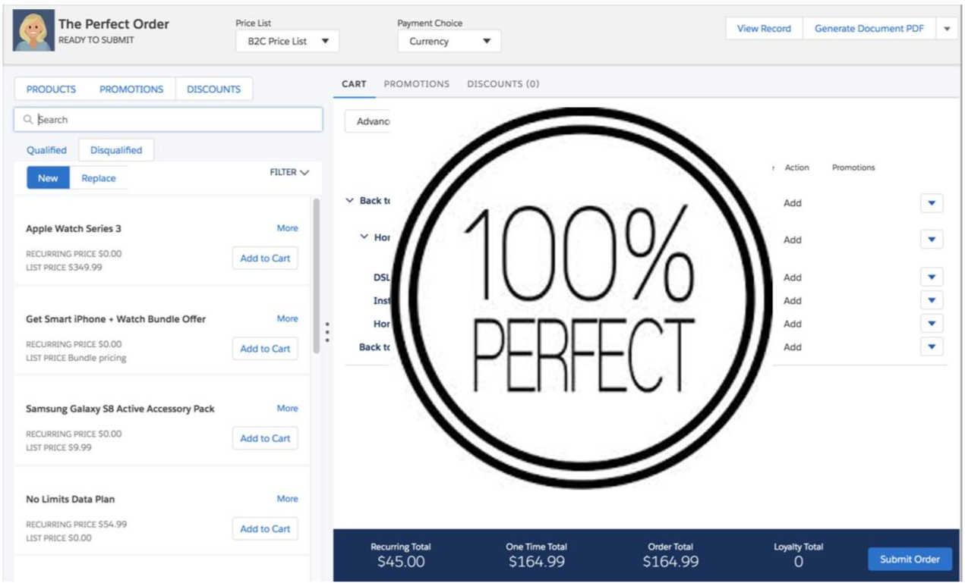
Pricing, Promotions, and Rules
Rules
In Vlocity CPQ the concepts of products and rules are important. Vlocity CPQ rules ensure that each order is a perfect order as defined by your business. You define your declarative rules to evaluate objects for conditions and then the rules run actions on those qualified objects. Examples: Lets say you want only some products to be available for customers in California and New York. To enforce that business logic you would create a CPQ rule. Another example, If you want only customers with good account standing to be eligible for specific promotion. Final Example, you would use a pricing rule to specify that of a customer order 10 or more of a certain produce the price is reduced for each product.
Rules ensure that:
Every order is a perfect order.
The right products and promotions are available to customers at the right price.
The appropriate penalties for product or service changes and cancellations are applied.

Slide 21
Pricing, Promotions, and Rules
Quiz
1. Pricing in Industries CPQ is designed as a component-based system with reusable items to allow seamless transition to new pricing structures.
A) True
B) False
2. Promotions is:
A) A system of rules that re-purposes products as promotions.
B) A way to use Salesforce promotions in any application.
C) An add-on Salesforce Industries Cloud module that provides flexible promotions functionality and automated product discounts.
D) A third-party promotions application.
Notes:
Answer:
1 – A
2 – C

Slide 22
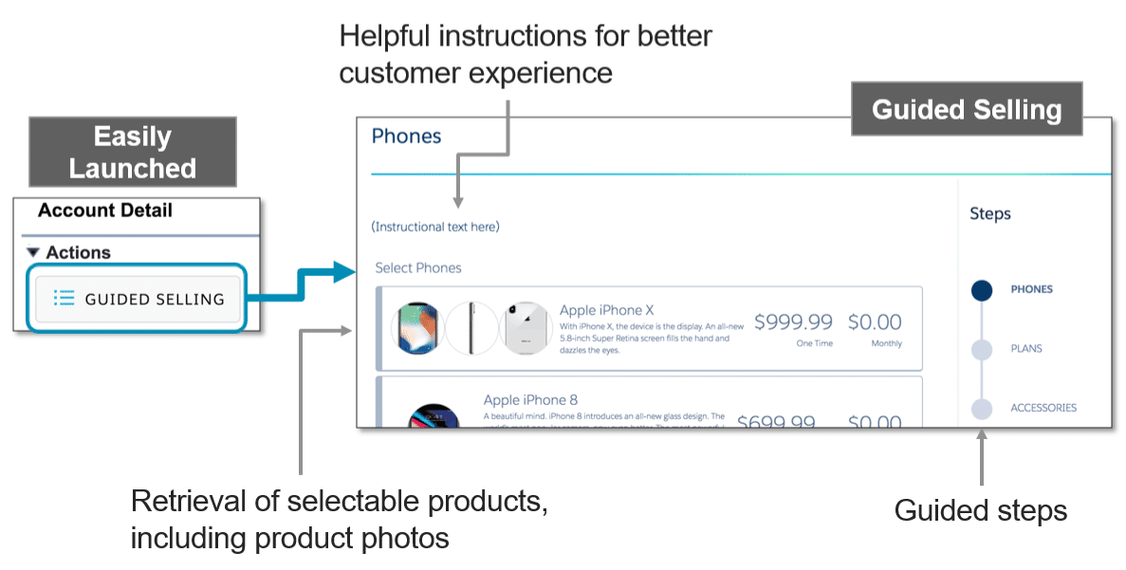
Guided Selling
Overview of Guided Selling
Guided Selling allows you to integrate the wealth of Industries CPQ functionality into a seamless, omnichannel digital experience. Guided selling is a consistent shopping experience that includes steps to guide the user through the process of recommending, selecting, and ordering products.
Guided Selling is built on the powerful OmniScript technology. OmniScripts allow you to design engaging customer interactions using a drag-and-drop design tool.
Notes:
OmniScript Samples
The Salesforce Industries Process Library provides many different examples of guided selling OmniScripts you can download and customize for your processes.

Slide 23
Guided Selling
Call Scripting
With Industries CPQ, you create guided-selling processes that:
Craft dynamic customer interactions without the need to develop code, with interactions running on multiple channels and devices.
Guide users through sales and service processes with fast, personalized responses and seamless integration to enterprise applications and data.
With guided selling, you can:
Enable needs analysis: Make possible the complete exploration of customer needs and drive products based on customer profile and articulated preferences.
Reduce average handling time: Guide customer service reps about the most efficient and effective path to complete orders and ensure order accuracy.
Increase NPS: Through reduced average handling time, ensure best fit services and one-and-done customer calls.
Notes:
Guided CPQ
Use the OmniScript Designer to create guided order-capture processes.

Slide 24
Pricing, Promotions, and Rules
Quiz
1. Guided selling can retrieve selectable products, including product photos.
A) True
B) False
2. Guided selling is...
A) Provided out of the box and is not configurable
B) Based on OmniScripts
C) A separately licensed Salesforce product
Notes:
Answer:
1 – A
2 – B

Slide 25
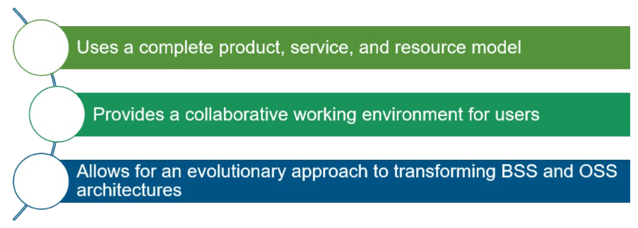
EPC
EPC gives your business an industry-leading, catalog-driven platform that revolutionizes the CPQ and order-management space by:
Using a metadata-driven approach to accommodate all the incarnations of a product as it travels from a twinkle in the eyes of the customer to the physical implementation in the customer’s hands.
Integrating with your end-to-end ecosystem using a complete product-service-resource (PSR) model to drive sales, configure-price-quote (CPQ), order-management, and order-fulfillment capabilities.
Using an evolutionary approach to transform both front-office and back-office systems into a master-catalog-driven architecture.
Notes:
Business support systems (BSS) are the components that a telecommunications service provider (or telco) uses to run its business operations towards customers. Together with operations support systems (OSS), they are used to support various end-to-end telecommunication services (e.g., telephone services).
Operations Support Systems (OSS), Operational Support Systems in British usage, or Operation System (OpS) in NTT are computer systems used by telecommunications service providers to manage their networks (e.g., telephone networks). They support management functions such as network inventory, service provisioning, network configuration and fault management. Together with Business Support Systems (BSS), they are used to support various end-to-end telecommunication services. BSS and OSS have their own data and service responsibilities.

Slide 26
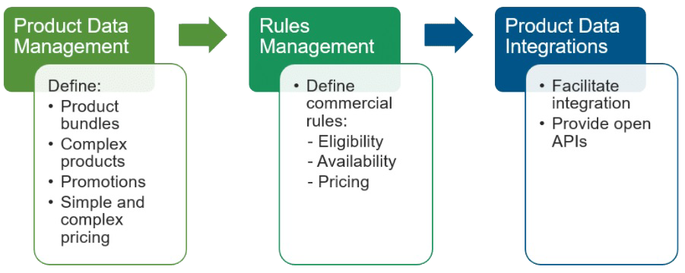
EPC
EPC Core Capabilities
Notes:
Guided CPQ
Use the OmniScript Designer to create guided order-capture processes.

Slide 27
EPC
EPC Reuse and Shared Resources
Shared Product Catalogue: Through an enterprise scope, enables the definition of a single product catalog in one place, with multiple subscribers and systems that consume the product catalog data.
Reusable Product Components: Enables the creation of products once, making them available for reuse across the enterprise by different systems.
Single User Interface: Gives you a single UI with common tools, enabling teams to collaboratively and rapidly create, manage, and deliver product offers to the market.

Slide 28
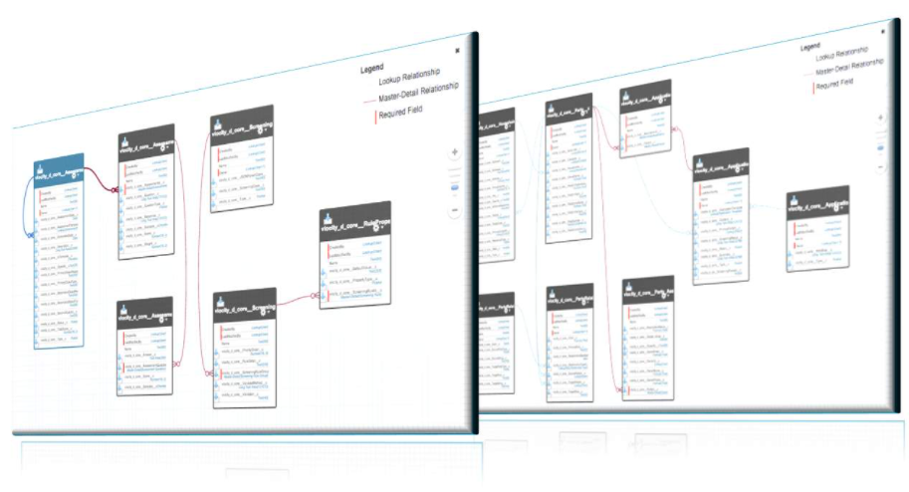
EPC
Industry Data Model
Our engineering, product, and information architecture teams have combined 240 years of vertical application design and software development experience to develop your Industry data model.
This diagram introduces product modelling and the concept of a product.
Product structure is a hierarchical decomposition of a product, often called the bill of materials.
Businesses need to be responsive to the unique needs of each customer by offering product derivatives to meet different consumer taste.
Essentially, product modelling is building your business hierarchy of products.

Slide 29
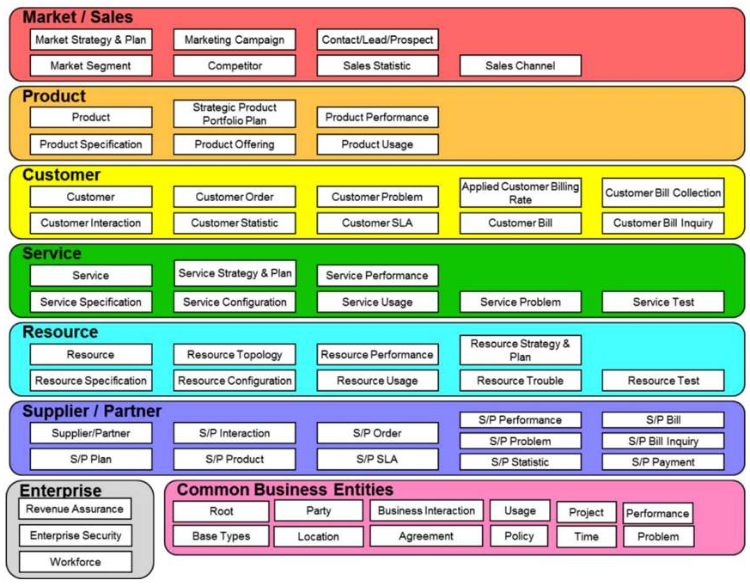
EPC
SID/TM Forum Model
To help you understand product modelling, this diagram shows a high-level view of how the EPC platform is flexible, adaptable, and compliant with the SID/TM Forum Frameworx model, which is the modelling standard for the Communications Industry.
EPC supports all levels of product definitions, including offers, product specifications, services, and resource specifications.
Marketing teams design product offers for sale to particular channels and customer segments with specific pricing.
Notes:
The TM Forum, formerly the TeleManagement Forum, is an international membership organization of communications service providers and suppliers to the communications industry. While OSS is generally dominated by proprietary and custom technologies, TM Forum promotes standards and frameworks in OSS and BSS.
TM Forum Frameworx
A suite of foundational libraries that enable a service-oriented, highly automated and efficient approach to business operations. A key element of the Open Digital Framework, TM Forum Frameworx is a living set of toolkits that has been widely adopted and proven to significantly improve agility in IT and operations, resulting in increased margins, lower costs and optimal customer experience.
For more information on the TM Forum, please check the TM Forum website.

Slide 30
EPC
PSR Layers
What's in the product layer?
Commercial view of what the business sells.
What's in the service layer?
Can include service specs and service configurations, such as a broadband internet service.
What's in the resource layer?
May include equipment, such as cable attributes and access ports, typically to support the network.

Slide 31
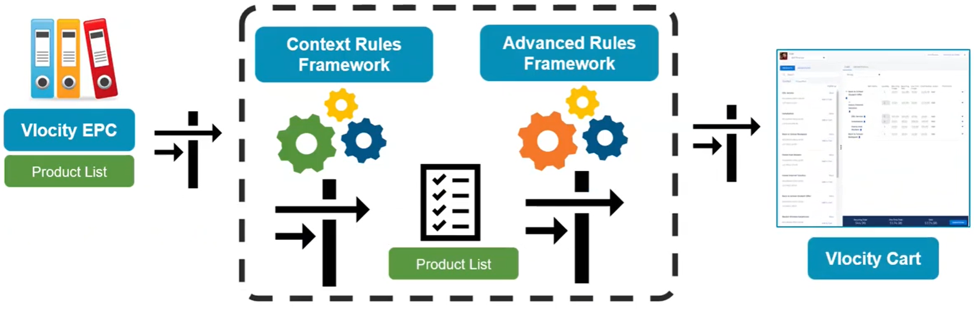
Guided Selling
From Catalog to Cart: Evolution of the Product List

Slide 32
EPC
Quiz
1. For what does the abbreviation "PSR" stand?
A) Purposeful service rating
B) Promotional sales rate
C) Product, service, resource
Notes:
Answer:
1 – C

Slide 33

Thank You

